Slide 1
Software for Digital Innovation (CIS4044-N)
Lecture 6
Data Processing and Visualisation

Slide 2
Schedule
Week | Lecture | IT lab and weekly feedback on progress
1 | Module introduction | Introduction to Python and IDLE
2 | Program flow control | Program flow control
3 | Functions and advanced lists | Functions and advanced lists | Portfolio 1 Feedback
4 | Data persistence, dictionaries, and tuples | Data persistence, dictionaries, and tuples
5 | Debugging, test cases, and version control | Debugging, test cases, and version control | Portfolio 2 Feedback
6 | Data processing and visualisation | Data processing and visualisation
7 | List comprehension and higher order functions | List comprehension, higher order functions | Portfolio 3 Feedback
8 | Object-Oriented Programming (OOP) | Object-Oriented Programming (OOP)
9 | Unit testing | Unit testing | Portfolio 4 Feedback
10 | Graphical user interfaces (GUIs) | Graphical user interfaces (GUIs)
11 | Networking and sockets | Network programming | ICA Support
12 | ICA support | Formative feedback | ICA support | Formative feedback
 | Winter Break
13 | ICA support | ICA submission
Note: The schedule may be adjusted based on class progress.

Slide 3
Learning Objectives
Practice, Practice, and more Practice!
Data Processing and Visualization
We’ve covered the vast majority of Python language concepts by week 5 (well done!)
Now, we get to put these into practice.
During the tutorial session try to combine loops, functions, variables, conditionals etc.
This session will be quite gentle on the raw Python language front. We’ll instead be working with libraries for data processing and data visualization.
By the end of this week, I’m hoping everyone will have a data file displayed as a scatter plot.

Slide 4
Libraries, a new concept…

Slide 5

Python: Using libraries
A “library” is a collection of pre-written code that we can “import” into our projects.
We will never have to look at or modify this code, only use it!
Before we can use libraries, we must first install them.
To install libraries, we use Python’s “package manager” which is called “pip”.

Slide 6
Why use libraries?
The Good…
The bad…
They save us a huge amount of time. Some of the libraries we’ll be working with later are extremely powerful and are built from many thousands of lines of Python.
They allow us to keep our Python programs small and focused. If we want to display a bar chart, writing all the code ourselves will make our program very large!
Libraries require learning. Think of each library as a new power-tool to learn to use: just because you can use a drill, doesn’t mean you can use an angle-grinder.
Libraries require that your end user also has those libraries installed. Our programs are no longer standalone. They have dependencies.

Slide 7
Loading and manipulating Big Data

Slide 8
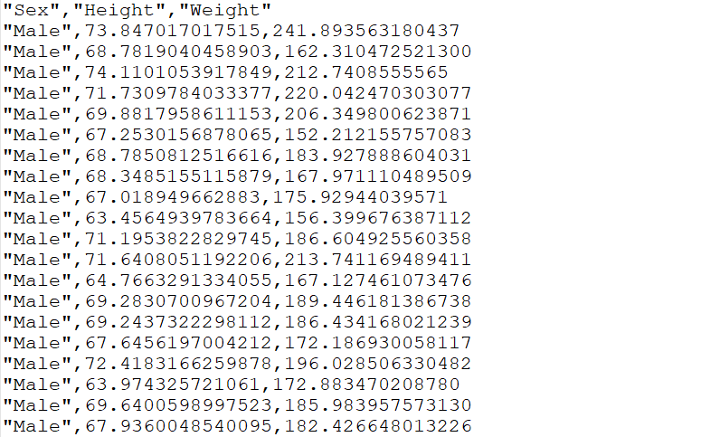
What is a CSV file?
CSV stands for comma separated values.
It’s a way of encoding a table (like a spreadsheet etc.) in a plain old text file.
The library that we’re going to be using, called Pandas, is capable of loading files formatted like this.
The figure on the right shows some of this CSV data: the heights and weights of 10,000 anonymised male and female reporting participants.

Slide 9
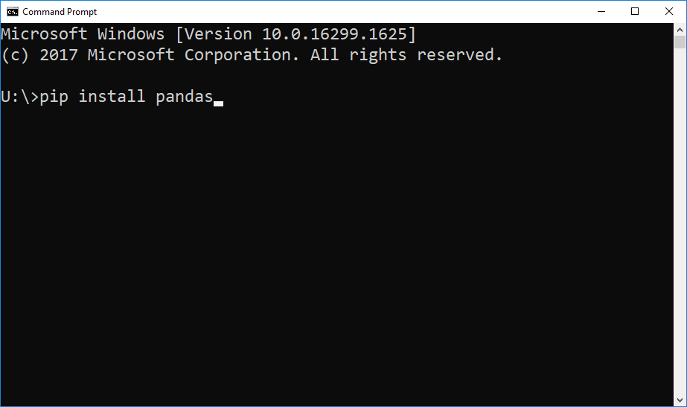
Installing Pandas
Installing Pandas is very simple, provided you get a little bit comfortable with the command line.
On Windows, this is the black window thing that lets you type text.
The command you need is:
pip install pandas (on Windows)
pip3 install pandas (on Linux)
These commands don’t go in your Python REPL, but in your command prompt (Windows) or terminal (Linux/Mac)!

Slide 10
Loading a CSV with Pandas
You can load CSV files with Pandas. A CSV file of some biometric data (people’s heights and weights) has been posted on Blackboard for you to practice with.
On the right here is the code we use to load the file into a data frame. You can think of this as an in-memory spreadsheet that you have complete control over with your code.
Note that we alias (rename) pandas to pd while importing it, to make our code more succinct.
import pandas as pd
# Load CSV file.
df = pd.read_csv("data.csv")
# Now we have the data frame # in our variable `df`.

Slide 11
Looping over a CSV
Looping through each row in a CSV file with Pandas is equally straightforward!
Let’s loop through the CSV file and get the average of the “height” column.
The code on the right uses iterrows() to go through the whole data frame using a for loop, adding up the heights and counting the rows.
Then, we print the total, divided by the number of rows (i.e. our average)
import pandas as pd
# Load CSV file. df = pd.read_csv("data.csv")
# Loop through and add up! total = 0 rows = 0 # Track row count. for i, row in df.iterrows(): total += row["height"] rows += 1
print(total / rows) # Print.

Slide 12
Loading a CSV with Pandas
We can also add new columns to data frames. We do this in exactly the same way as adding to a regular dictionary.
On the right here, we calculate the weight/height ratio of each person in our dataset and add them in a new column called “WHR”.
Side note: always be careful when analysing data like this. Weight and height alone are not sufficient to make judgements about people’s health, for example.
import pandas as pd
# Load CSV file. df = pd.read_csv("data.csv")
# Loop through and calculate # weight/height ratios. whrs = [] for i, row in df.iterrows(): whr = row["weight"] / row["height"] whrs.append(whr) df["WHR"] = whrs # Add new column.

Slide 13
Saving a CSV with Pandas
Let’s save our CSV now. It’s quite straightforward, as before.
All we need to do it call the to_csv function on our data frame and pass it the file path in which to save our output.
From here, it’s a simple job to read it back in again for further processing, or import it into Excel etc. to perform further analysis on it.
# Simply save our dataframe.
df.to_csv("output.csv")

Slide 14
Visualising this data

Slide 15
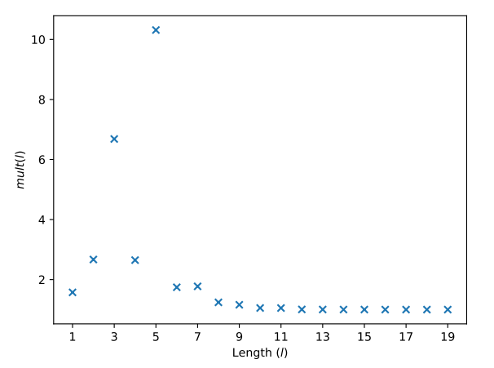
Libraries for Data Visualisation
Python supports libraries that allow us to plot some very nice graphs, such as the one on the right.
We’ll be looking at scatter plots (like the example here), bar charts and line graphs.
Stick around for the end of the session and we’ll take a look at pie charts, another powerful visual aid for high-level summarisation of data.

Slide 16
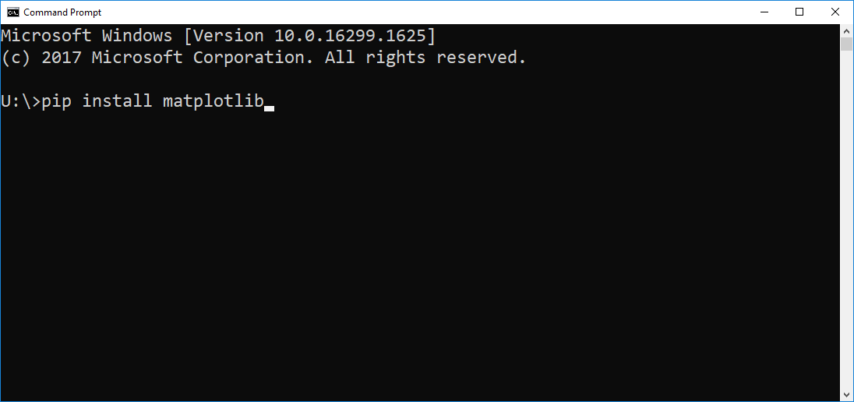
Installing MatPlotLib
Again, installation is very simple, via the command line.
The command you need is:
pip install matplotlib (on Windows)
pip3 install matplotlib (on Linux)
Again, these commands don’t go in your Python REPL, but in your command prompt (Windows) or terminal (Linux/Mac)!

Slide 17
Scatter Plots

Slide 18
Plotting some random data as a Scatter plot
To warm up, let’s generate some random data and plot it as a scatter plot.
On the right, we generate two lists of 30 numbers, each containing random numbers between 0 and 100.
After importing matplotlib on line 1 (and renaming it to “plt” to streamline our code) we then call scatter() to place this data into a scatter plot and show() to display the visualisation.
import matplotlib.pyplot as plt
from random import randint
# Generate 2 sets of 30 random # numbers between 0 and 100. x = [randint(0, 100) for _ in range(0, 30)] y = [randint(0, 100) for _ in range(0, 30)]
# Plot and show scatter graph. plt.scatter(x, y) plt.show()

Slide 19
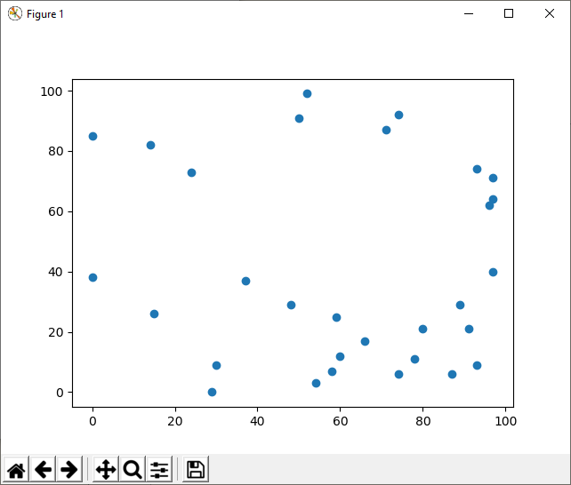
The result of our code!
The code on our previous slide produces this window on the right.
By clicking the “save” button in this window, we can save our visualisation as an image (*.png/*.svg/*.pdf for example) to include it in our reports, research or publications!
Now, let’s put this into more context by plotting heights against weights loaded from the CSV file we worked with earlier…

Slide 20
More meaningful Scatter plots
Plotting random data isn’t a great deal of use, however.
On the right, we load our CSV file of heights and weights, and use it with scatter() straight away. Note that we also add a title to the plot.
This produces a scatter plot that shows what we expect: in general, taller people tend to be heavier.
Whenever you have two independent variables like this (e.g. height and weight) a matplotlib scatter plot is the ideal way to visualise it!
import matplotlib.pyplot as plt
import pandas as pd
# Load CSV file.
df = pd.read_csv("data.csv")
# Plot and show scatter graph. plt.scatter(df["Height"], df["Weight"]) plt.title("Height against weight") plt.show()

Slide 21
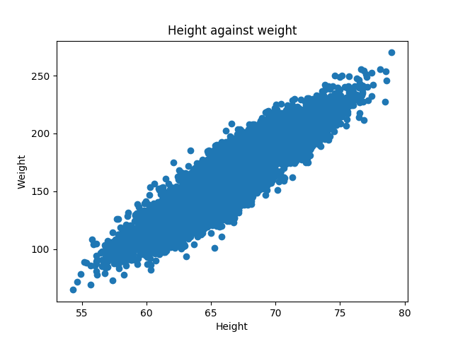
More meaningful Scatter plots (cont.)
You can see the result of running the code on the previous slide on the right. Notice our title is also in there now.
If we like, we can add axis labels like so:
plt.xlabel("Height")
plt.ylabel("Weight")
Try adding these in and re-running the code to see the result. The sky really is the limit here, and there’s so much more to learn. See here for a really interesting example: https://matplotlib.org/3.1.3/gallery/shapes_and_collections/scatter.html

Slide 22
Line graphs

Slide 23
Line graphs for continuous data
When our data is continuous, it makes much more sense to use a line graph to plot it.
Take the code on the right, for example. We start by generating the numbers 0 to 99 in x, and using this to generate the first 99 square numbers in y.
Plotting this will give us an exponential curve…
import matplotlib.pyplot as plt
from random import randint
# Generate numbers 0 to 99 in x. x = range(0, 100)
# From this, compute squares. y = [n**2 for n in x]
# Plot and show line graph using # the plot() function. plt.plot(x, y) plt.show()

Slide 24
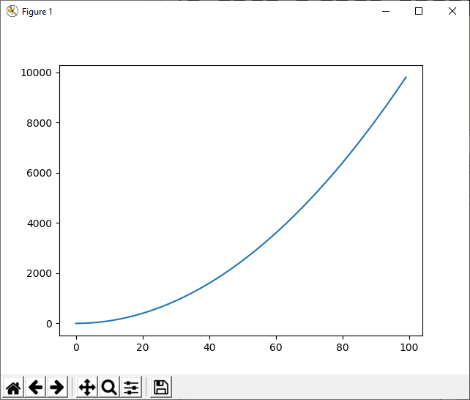
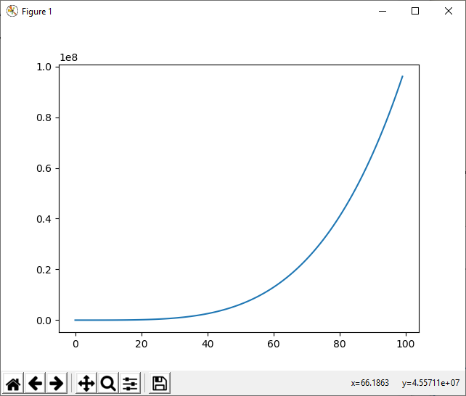
Line graphs for continuous data (cont.)
Here’s the result from the previous slide…
And here’s what happens if we change n**2 to n**4…

Slide 25
Bar Charts

Slide 26
Bar charts for bucketed data
When we can group our data up into “buckets”, a bar chart is usually a good idea to use to visualise it.
The example on the right will roll 100 6-sided dice, and show how many times each number turned up on a bar chart.
I’m keeping these examples quite short using list comprehensions. Copy this code and experiment with it to discover how it works!
import matplotlib.pyplot as plt from random import randint
# Roll 100 6-sided dice. rolls = [randint(1, 6) for _ in range(0, 100)]
# Count the number of times each number # was rolled. numbers = range(1, 7) bars = [rolls.count(n) for n in numbers]
# Plot and show bar chart. plt.bar(numbers, bars) plt.show()

Slide 27
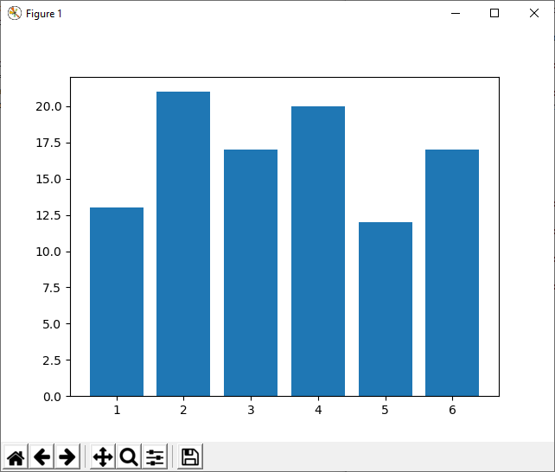
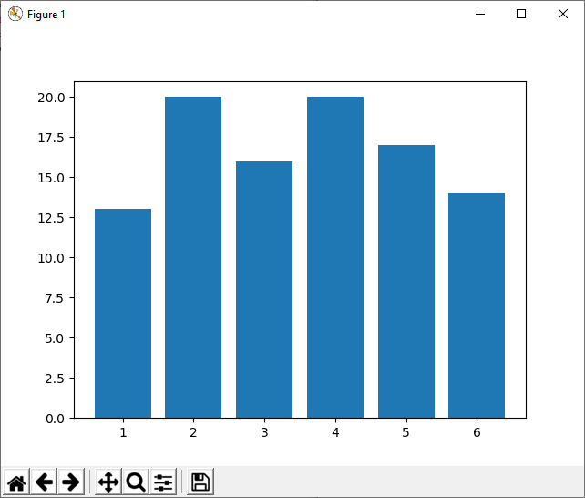
Bar Charts for Bucketed Data (cont.)
Here’s the result from the previous slide…
Here’s the same program again, remember It’s random!

Slide 28
Any questions?
Module Leader James Fairbairn
Email j.fairbairn@tees.ac.uk
Office G0.27 (Greig building)
Module Tutor Martin Kane
Email m.kane@tees.ac.uk
See Blackboard for online materials: https://eat.tees.ac.uk

